Slide 1
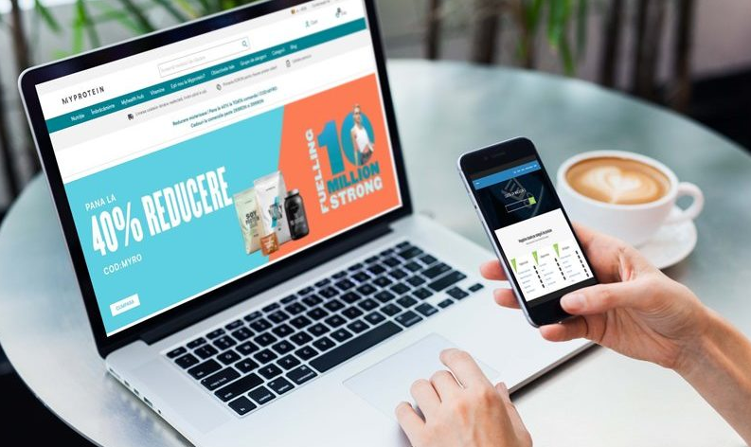
Final Project Testing MYPROTEIN
by Cristian Muresan
www.myprotein.ro

Slide 2

TABLE OF CONTENTS
About
Testing Approach
Test case overview
Testing types
Tools Used
Test Cases Results
Bugs Overview
UI Tests
API Tests
Conclusions
Lessons Learned
“Thank you !”

Slide 3
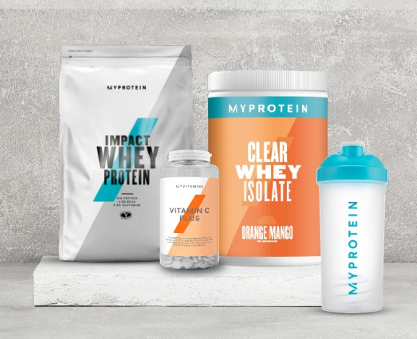

MYPROTEIN
Web application
Online store that delivers quality products in over 70 countries.
Founded in 2004, Myprotein is now Europe’s No. 1 sports nutrition brand.

Slide 4
TESTING APPROACH
Mind Map: to determine the structure and to learn the application.
Smoke testing for the main functionalities: Homepage, Settings, Account, Search Bar, Category, Products, Add to Cart, Shopping Cart, Checkout, Shipping, Footer.
Exploratory testing performed for: Homepage, Category, Account, Products, Search Bar and Shopping Cart. The bugs found were documented and screenshots were taken for easier replication.
Component testing, Integration testing, Negative testing, Compatibility, UI, Usability, Boundary, Equivalence partitioning.
Write Smoke test cases and execute them.
The app was tested in production.
Write test report.

Slide 5
TEST CASE OVERVIEW

Slide 6
Testing types
PERFORMED
Functional testing
Smoke testing
Exploratory testing
Positive Testing
Negative testing
Compatibility testing
Usability testing
APPLICABLE
Performance testing
Security testing
API automated testing
UI automated testing
Stress testing
Load Testing

Slide 7

Tools used
Xmind – Mind Maps
TestLink – Test case management
Mantis Bug Tracker – Bug reporting
QuickTime Player – Screen recording
Excel – Test data
Visual Studio Code – JavaScript
Cypress – Automated testing
Postman – API testing

Slide 8
Test Cases Results
Functionality | Total | Pass | Failed | Blocked | Not Run | Defects
Homepage | 1 | 1 | 0 | 0 | 0
Settings | 1 | 1 | 0 | 0 | 0
Account | 14 | 13 | 1 | 0 | 0 | 0031599
Search Bar | 3 | 2 | 1 | 0 | 0 | 0031574
Category | 2 | 2 | 0 | 0 | 0
Products | 8 | 8 | 0 | 0 | 0
Add to Cart | 5 | 4 | 1 | 0 | 0 | 0031852
Shopping Cart | 9 | 9 | 0 | 0 | 0
Checkout | 4 | 4 | 0 | 0 | 0
Shipping | 2 | 2 | 0 | 0 | 0
Footer | 9 | 7 | 2 | 0 | 0 | 0031575, 0031576
Non Functional | 6 | 3 | 0 | 0 | 3
Overall Results | 64 | 56 | 5 | 0 | 3 | 5
Percentge | 100% | 87.5% | 7.8% | 0% | 4.7% | 7.8%

Slide 9
Bugs overview

Slide 10
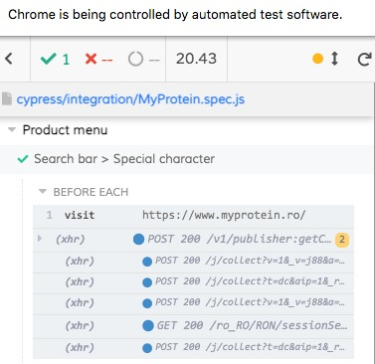
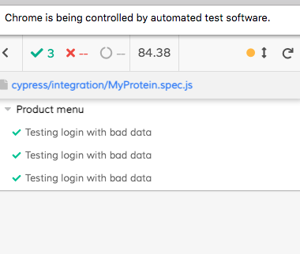
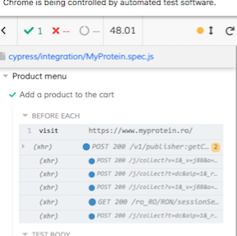
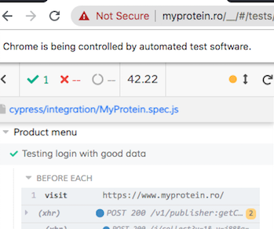
UI Tests

Slide 11
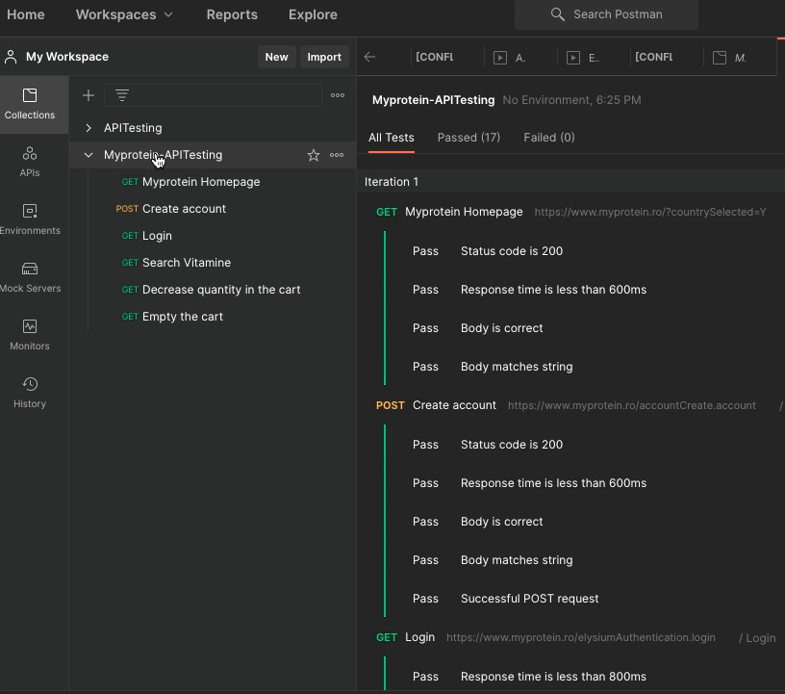
Api tests

Slide 12

Conclusions
64 Test Cases were executed: 56 passed, 5 failed and 3 not run.
8 Automated Tests were written and executed: 5 passed and 3 not run.
The tests not run were due to the app
being in production.
7 low-priority bugs were discovered.
The data type used for testing: Valid,
Invalid, Blank.
Most of the bugs were identified
while testing the boundaries
and while performing negative
testing.
Prior to release, the failed test
cases should be run again.
Considering that no critical or major bugs were found, the app can be used without any problems.

Slide 13


Lessons learned
Lack of requirements.
Understanding the main purpose of the
app helps in writing test cases.
Don’t delete your drafts.
Put yourself in the user’s shoes.
Time management is very important.
Start with the mind map
Exploratory testing helps to learn the app
functionalities.
Focus on main functionalities but don’t
neglect the smaller features.
Tell yourself “I am doing the best job in
the world as I am helping in
improving something”.

Slide 14
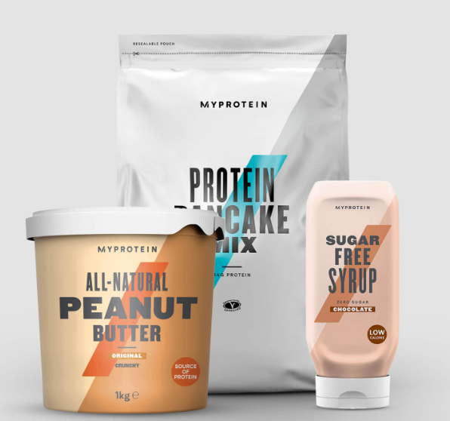
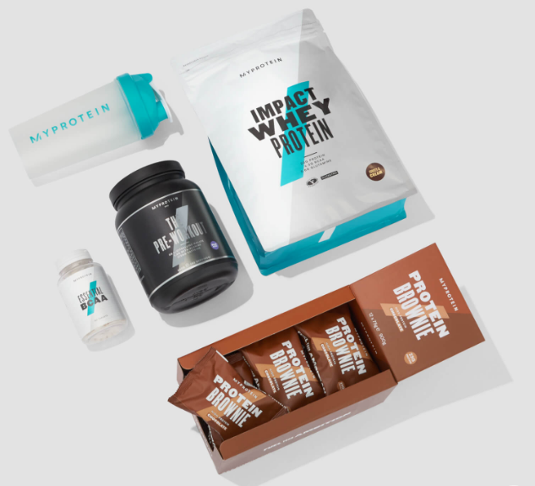
THANK YOU !
FEEDBACK
RECOMMENDATIONS

